Slide 1
N G Ajjanna
Asst professor
Dept. of E&E Engineering
JNNCE,Shimoga

Slide 2
Electric Motors
(BEE401)

Slide 3
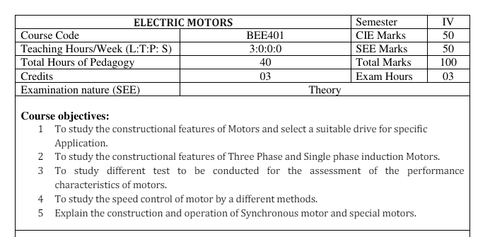

Slide 4
Module-1
DC Motors:
Construction and working principle.
Back E.M.F and its significance,
Torque equation,
Classification,
Characteristics of shunt, series & compound motors,
Speed control of shunt motor,
Application of motors.
Losses and Efficiency- Losses in DC motors, power flow diagram, efficiency, condition for maximum efficiency.

Slide 5
Module-1
Testing of DC Motors:
Direct & indirect methods of testing of DC motors:
Swinburne’s test.
Field's test.
Merits and demerits of tests.
Numerical as applicable

Slide 6
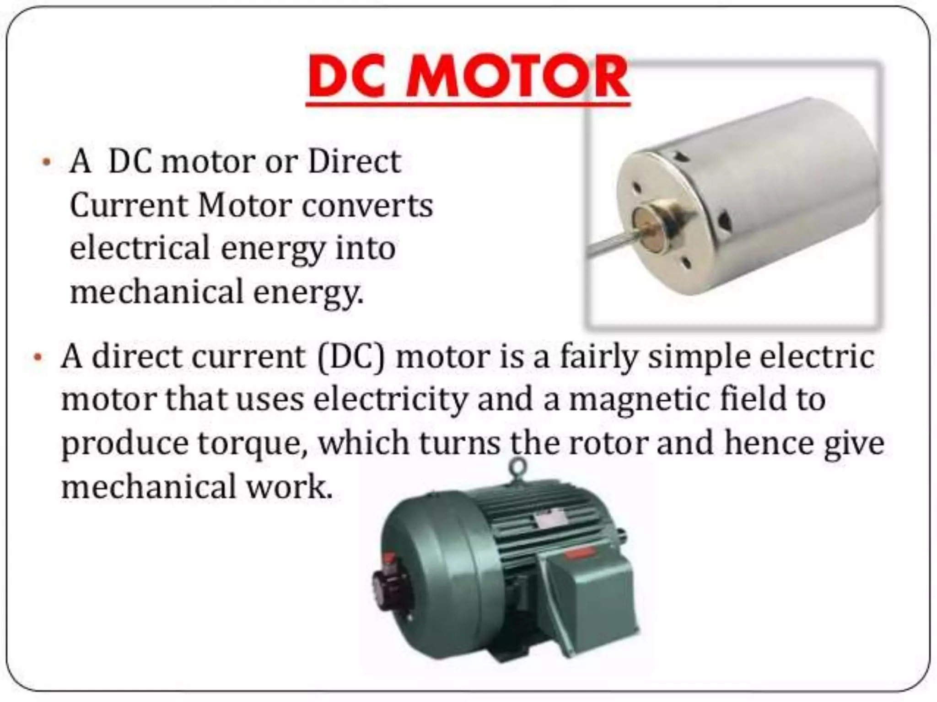

Slide 7
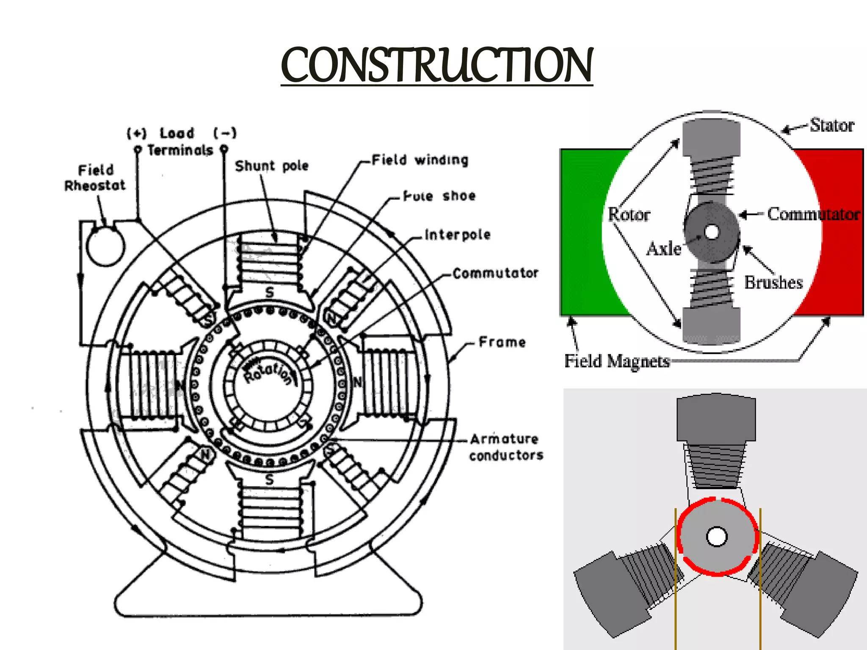

Slide 8
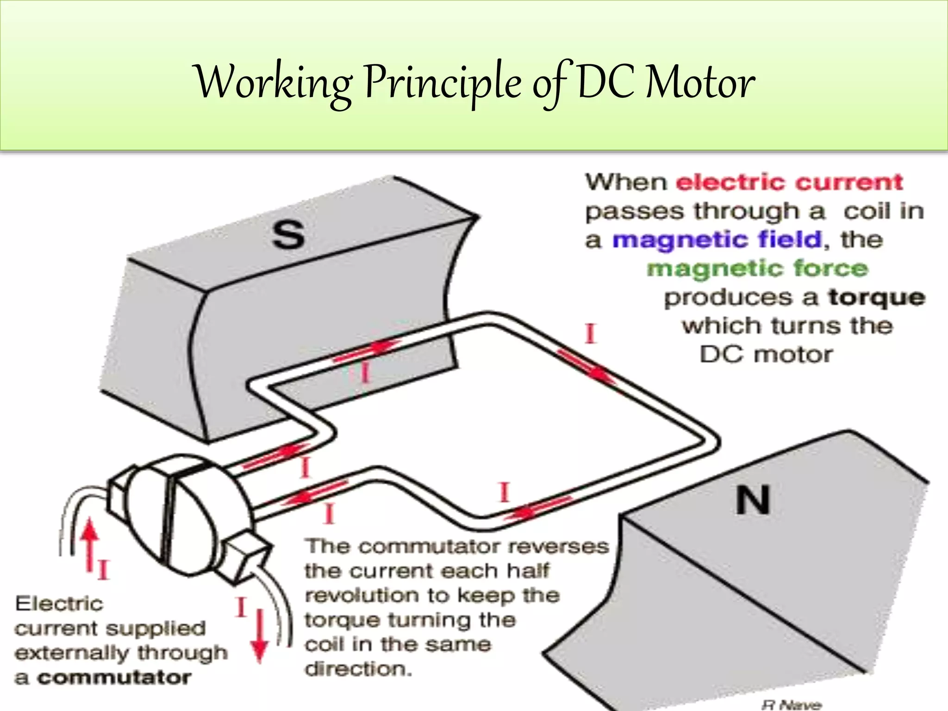

Slide 9
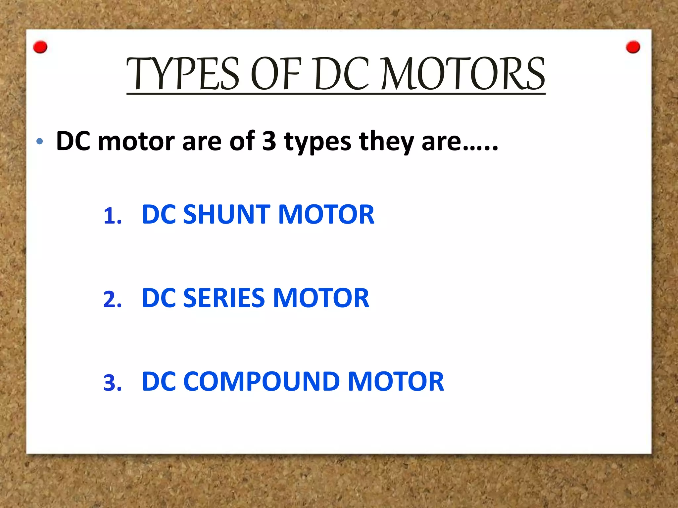

Slide 10
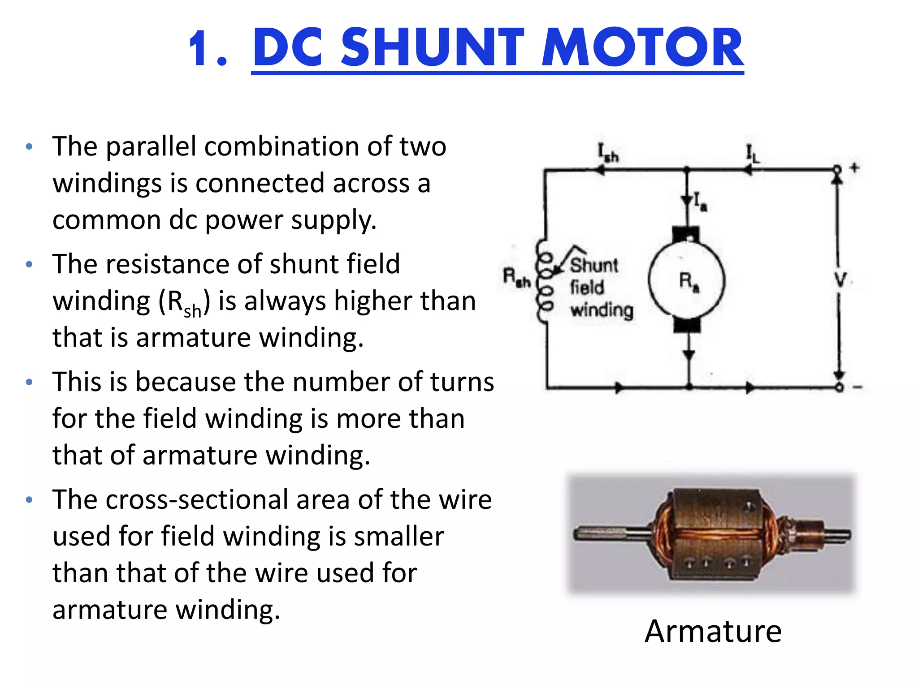

Slide 11
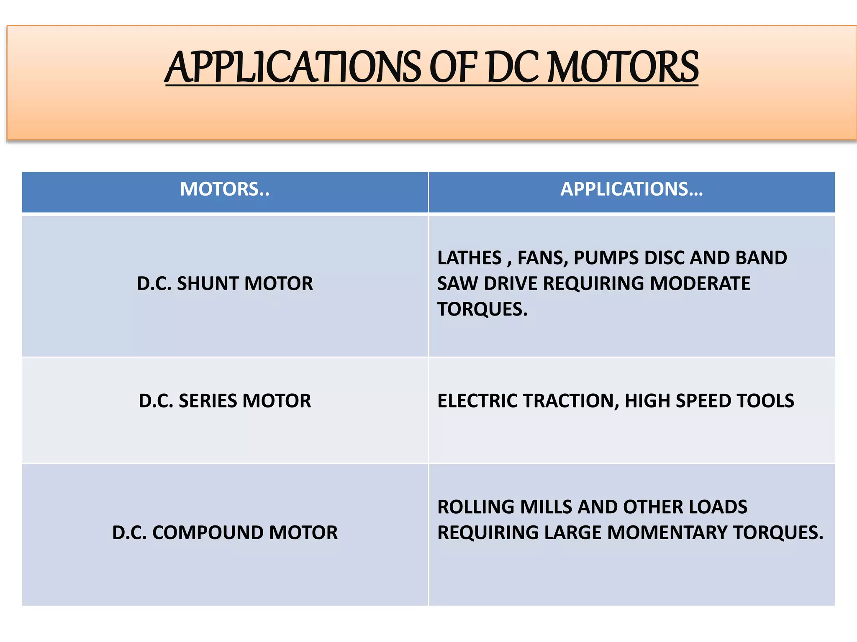
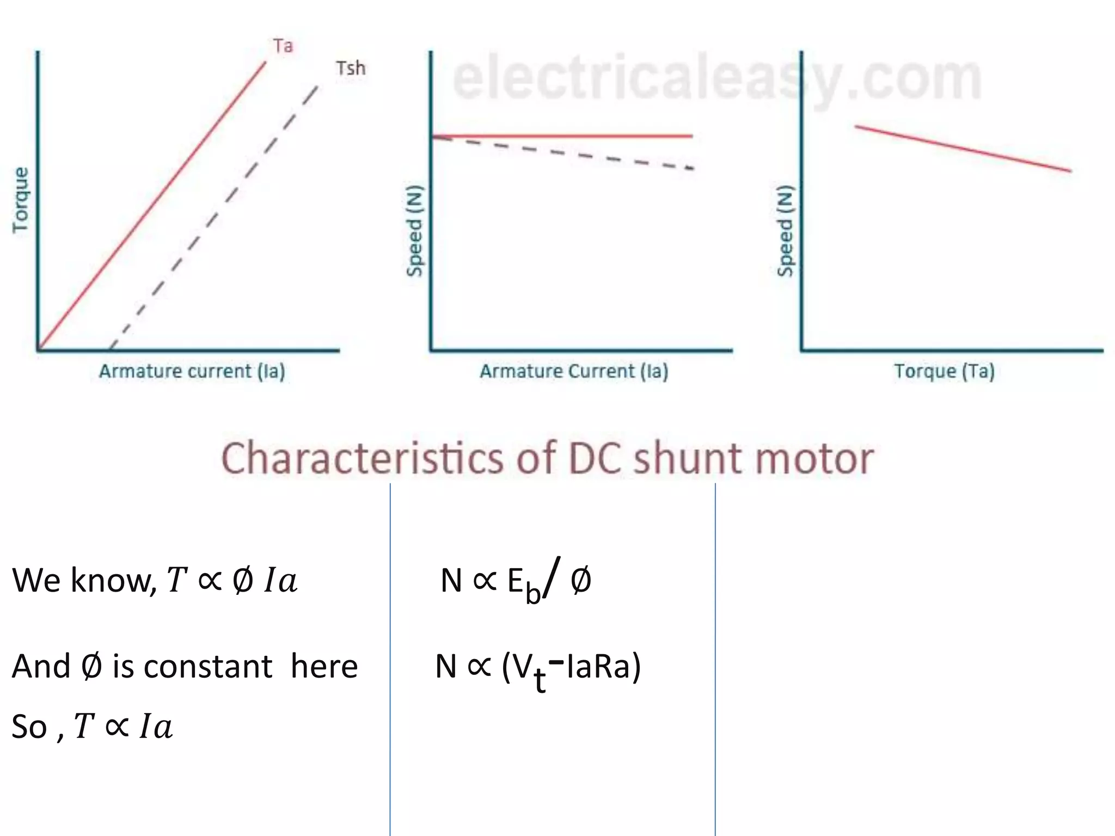

Slide 12
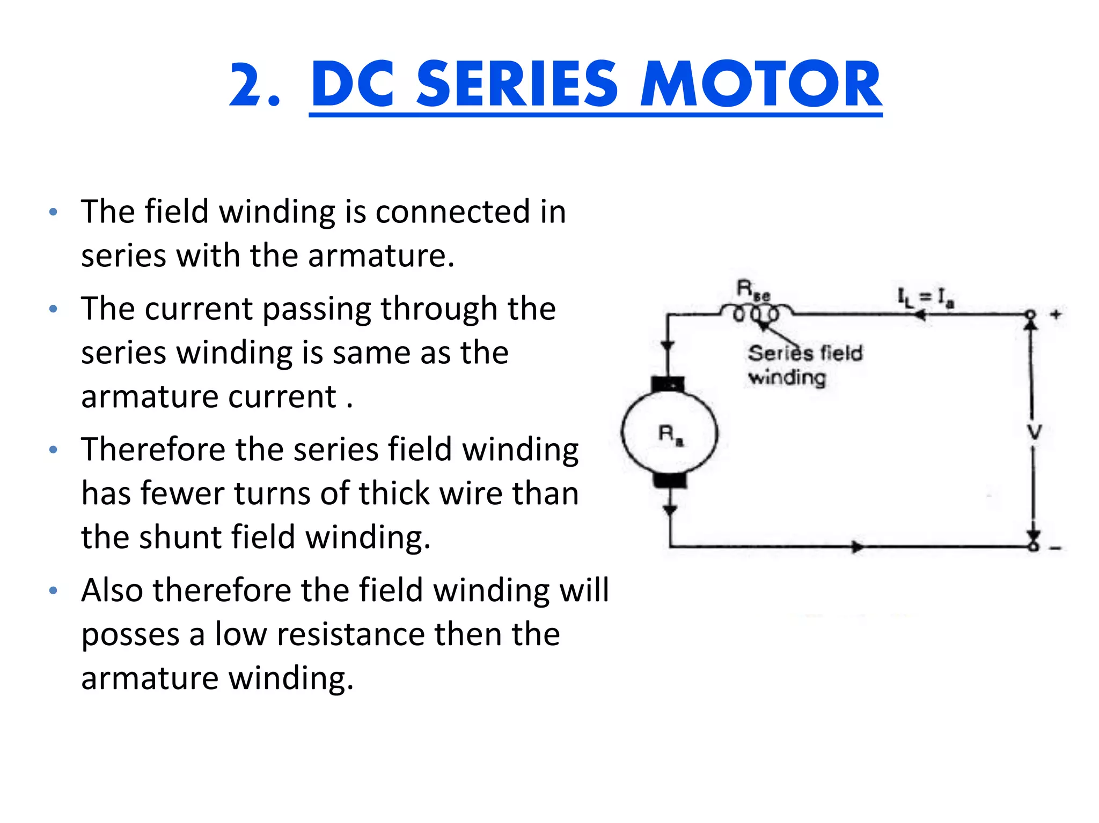

Slide 13
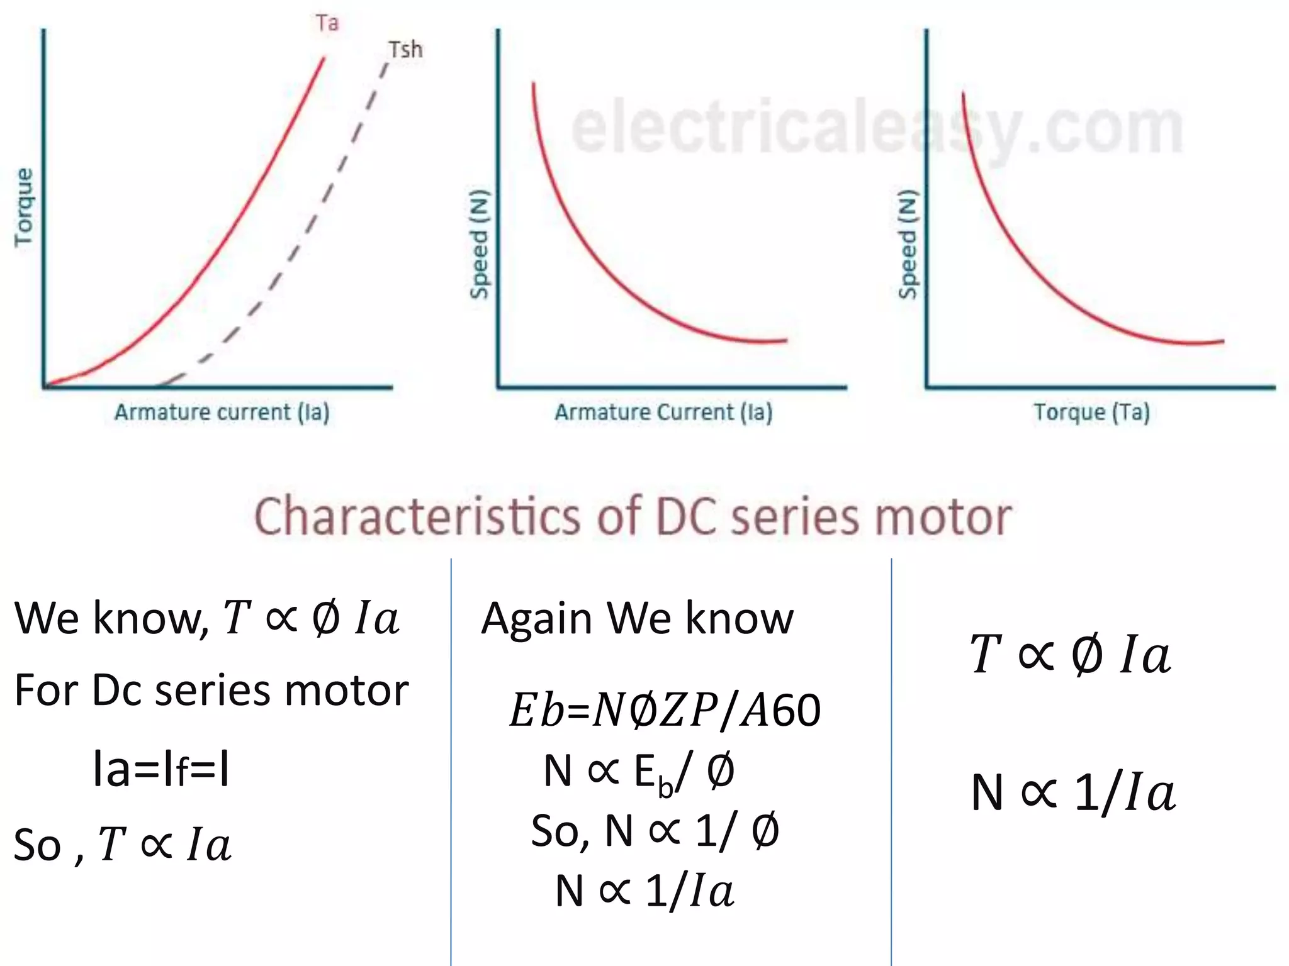

Slide 14
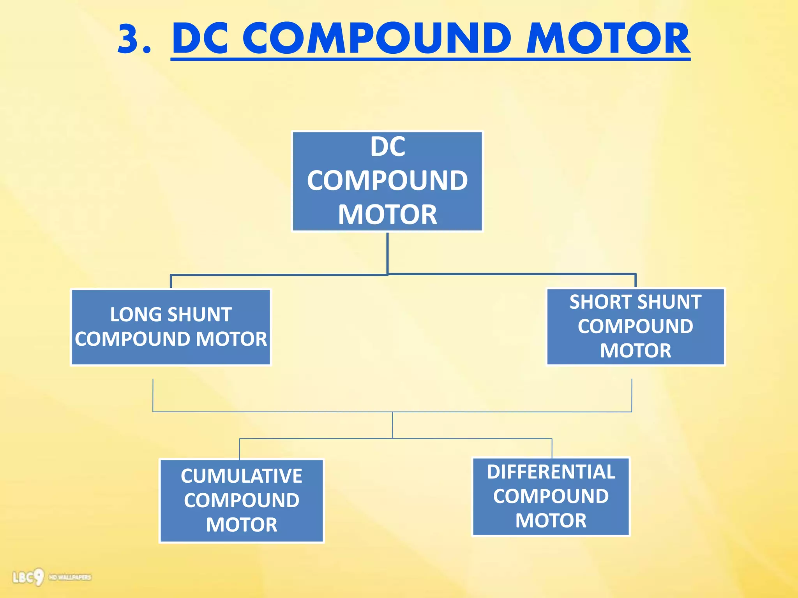

Slide 15
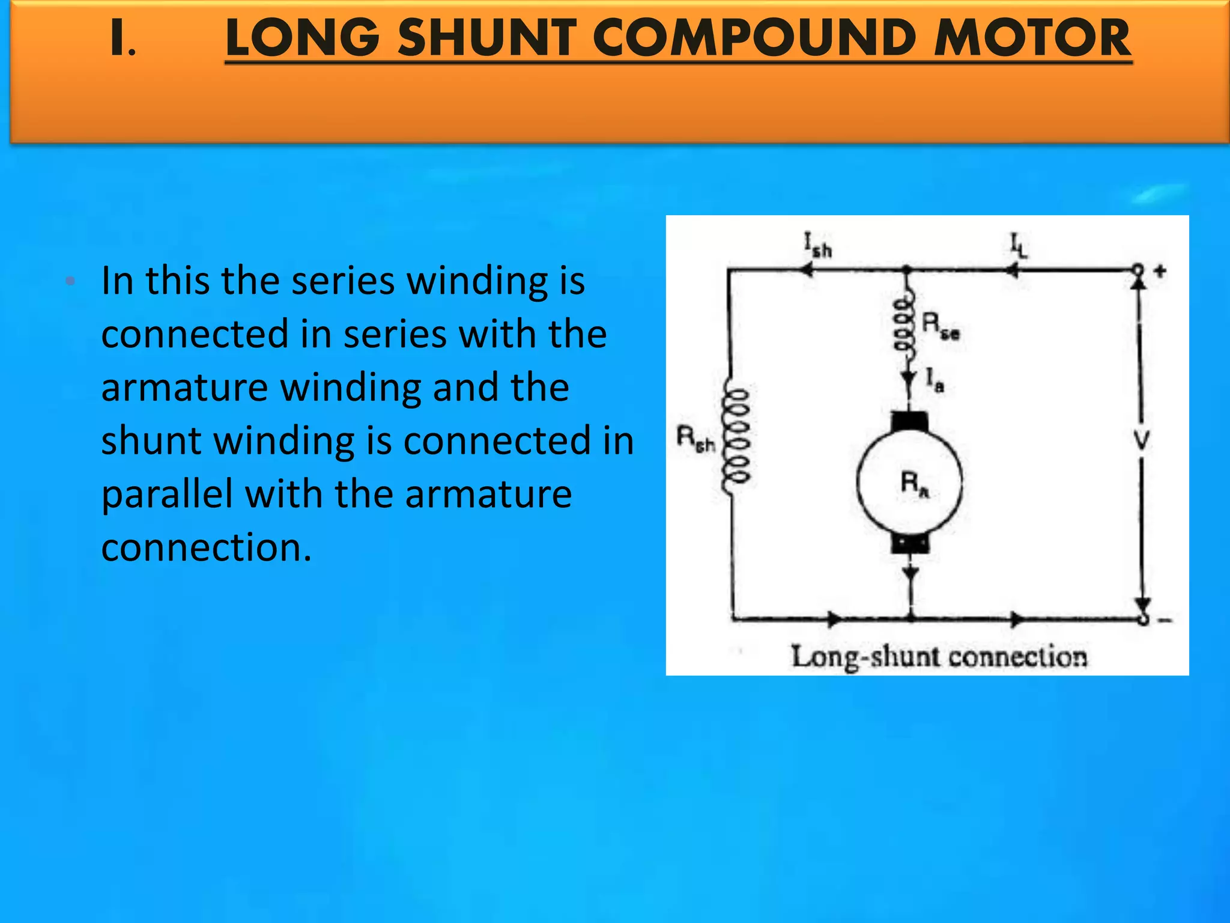

Slide 16
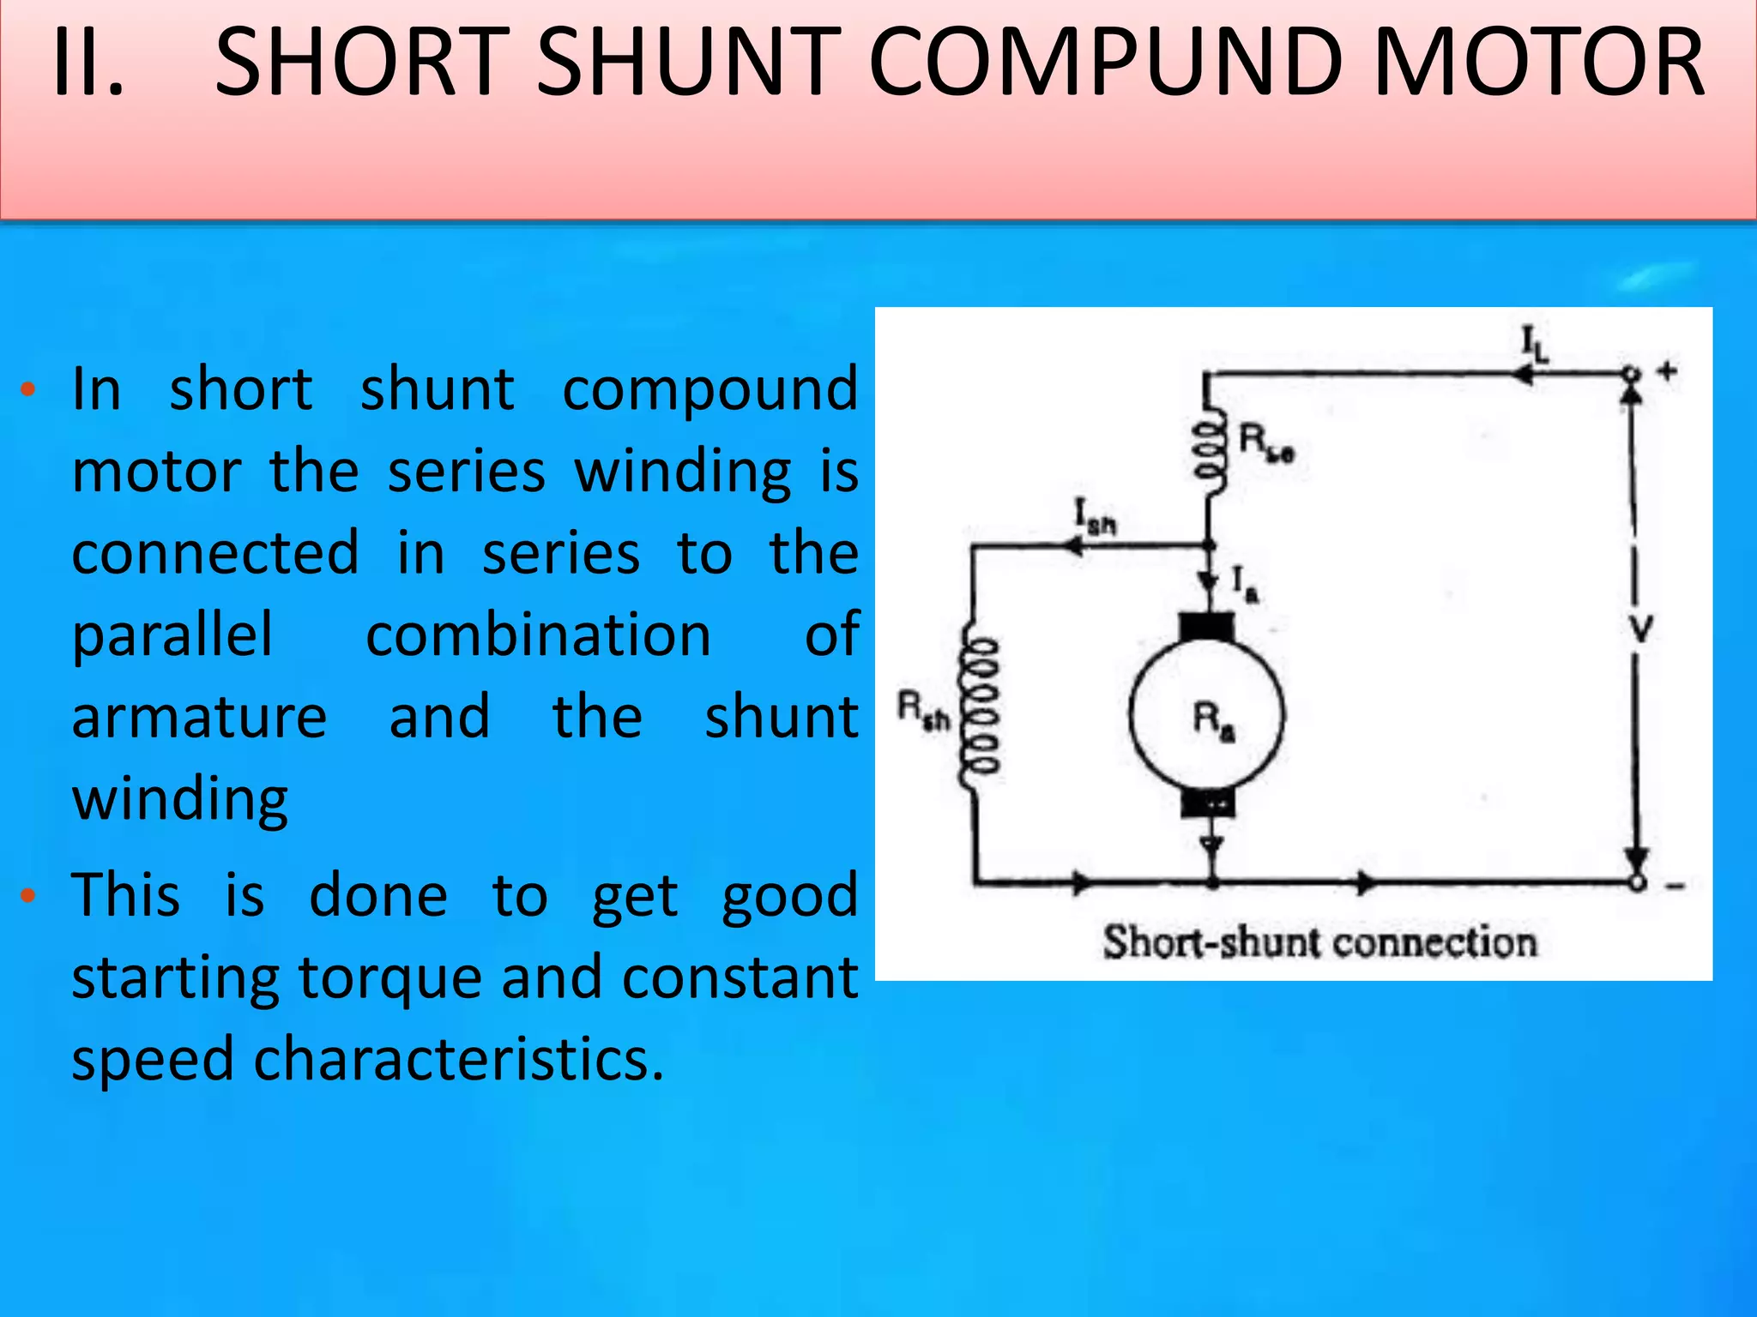

Slide 17
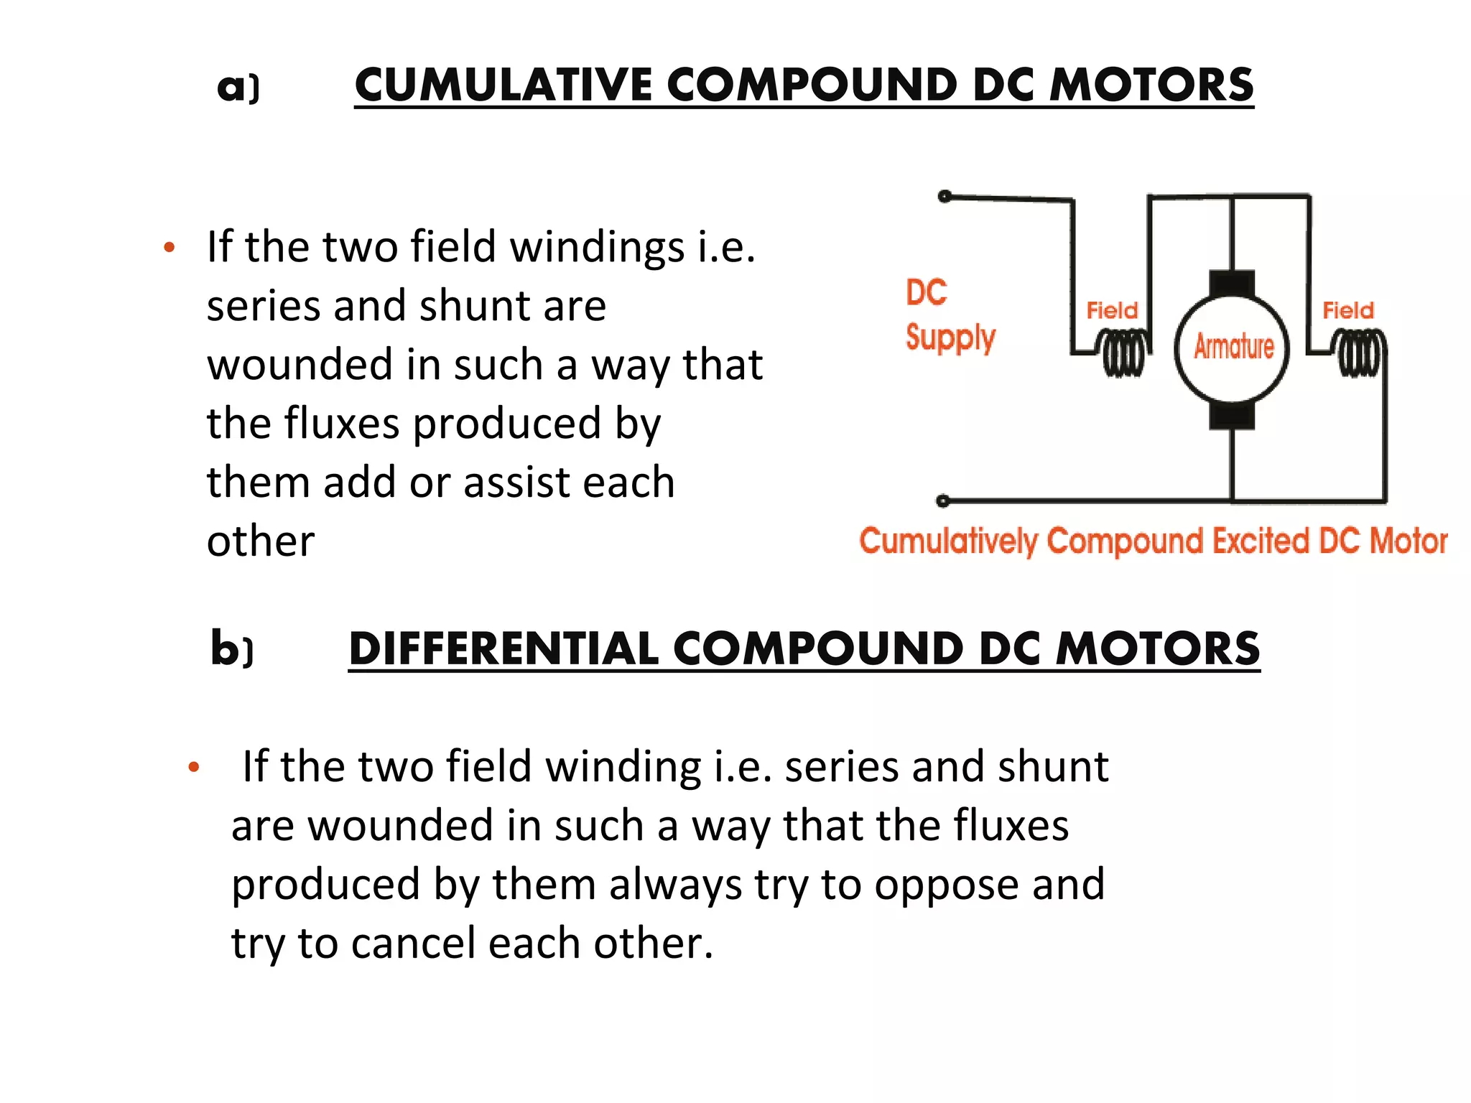

Slide 18
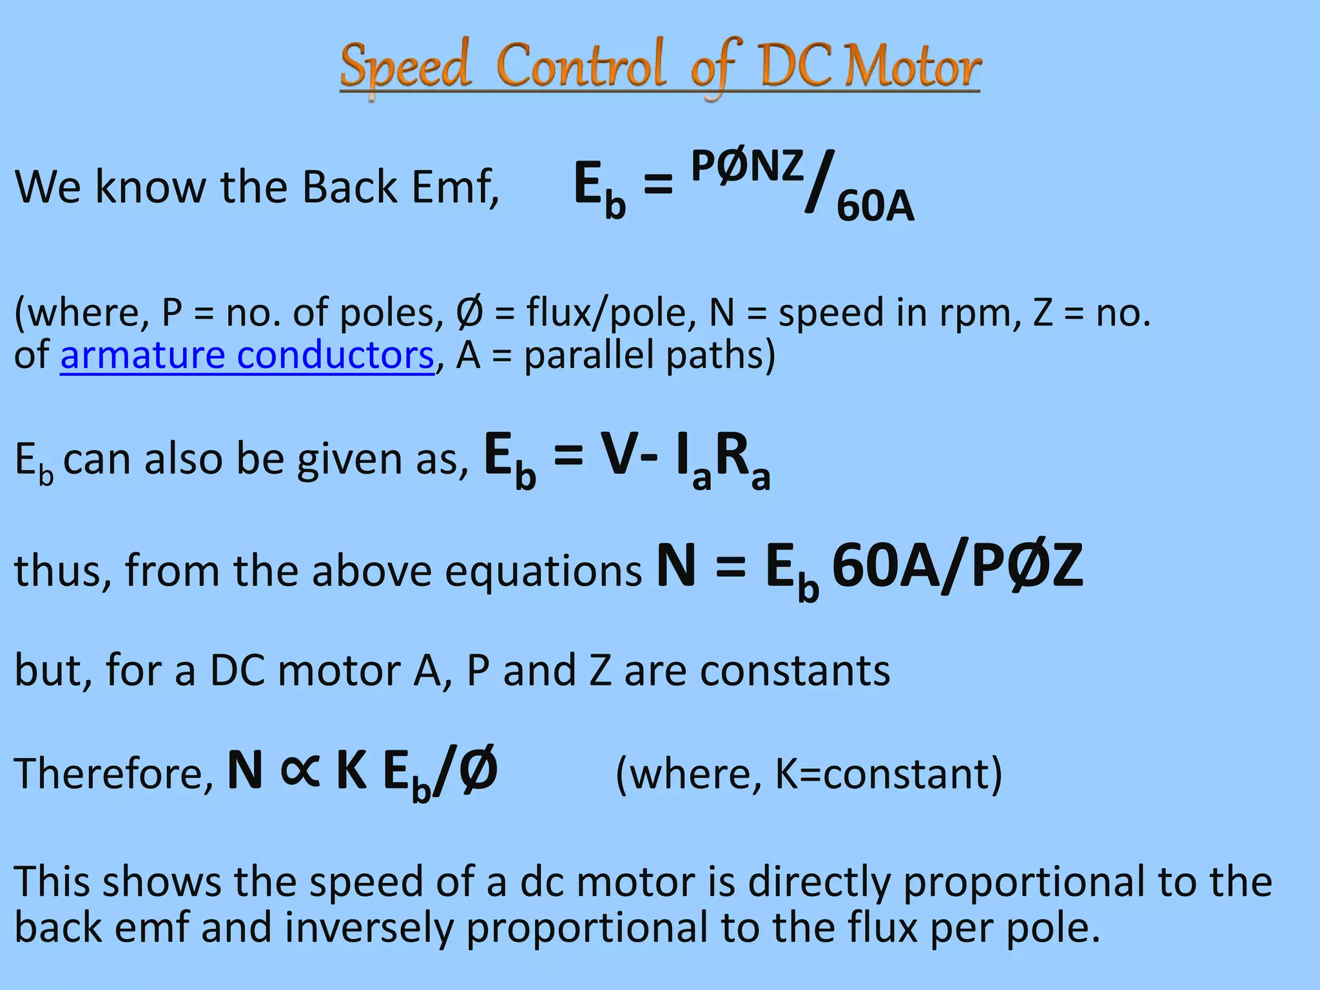

Slide 19
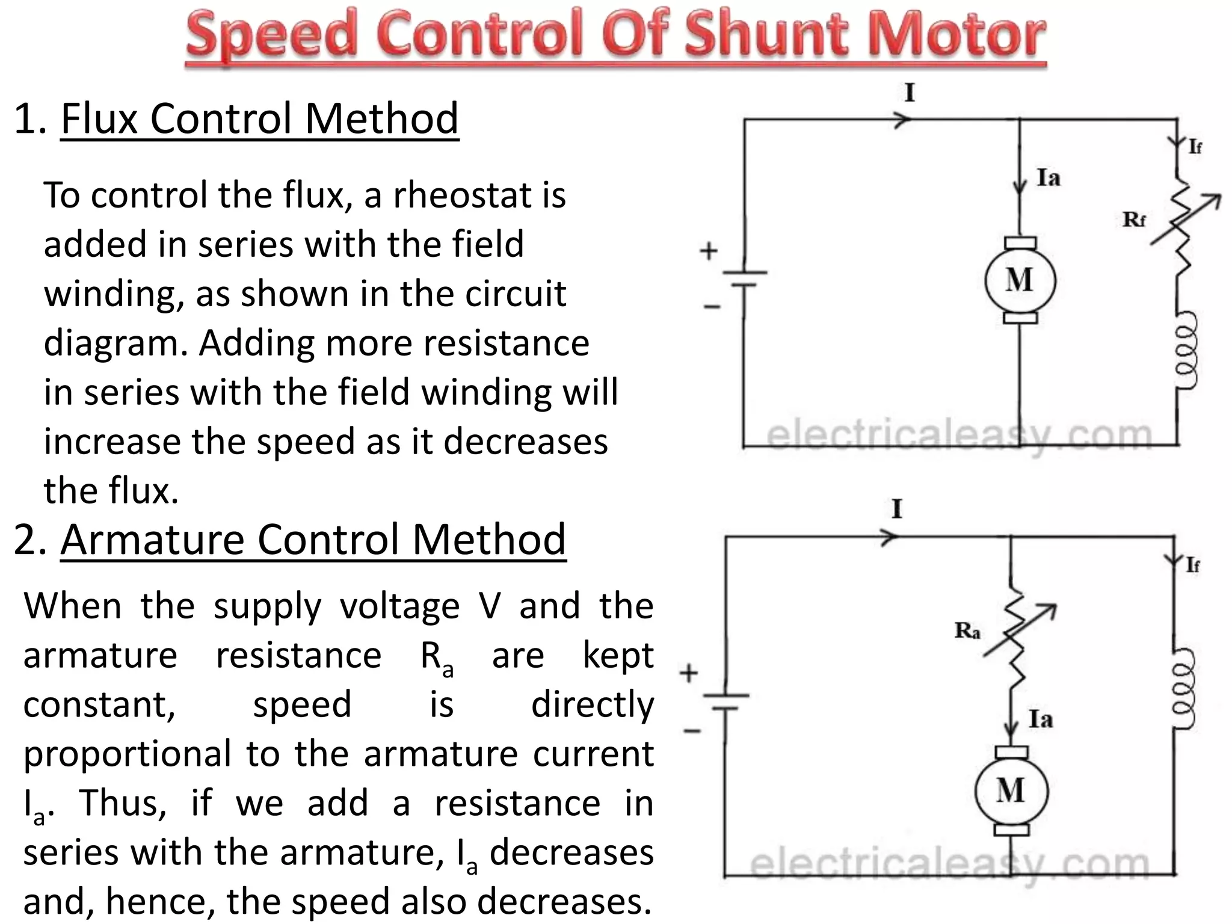

Slide 20
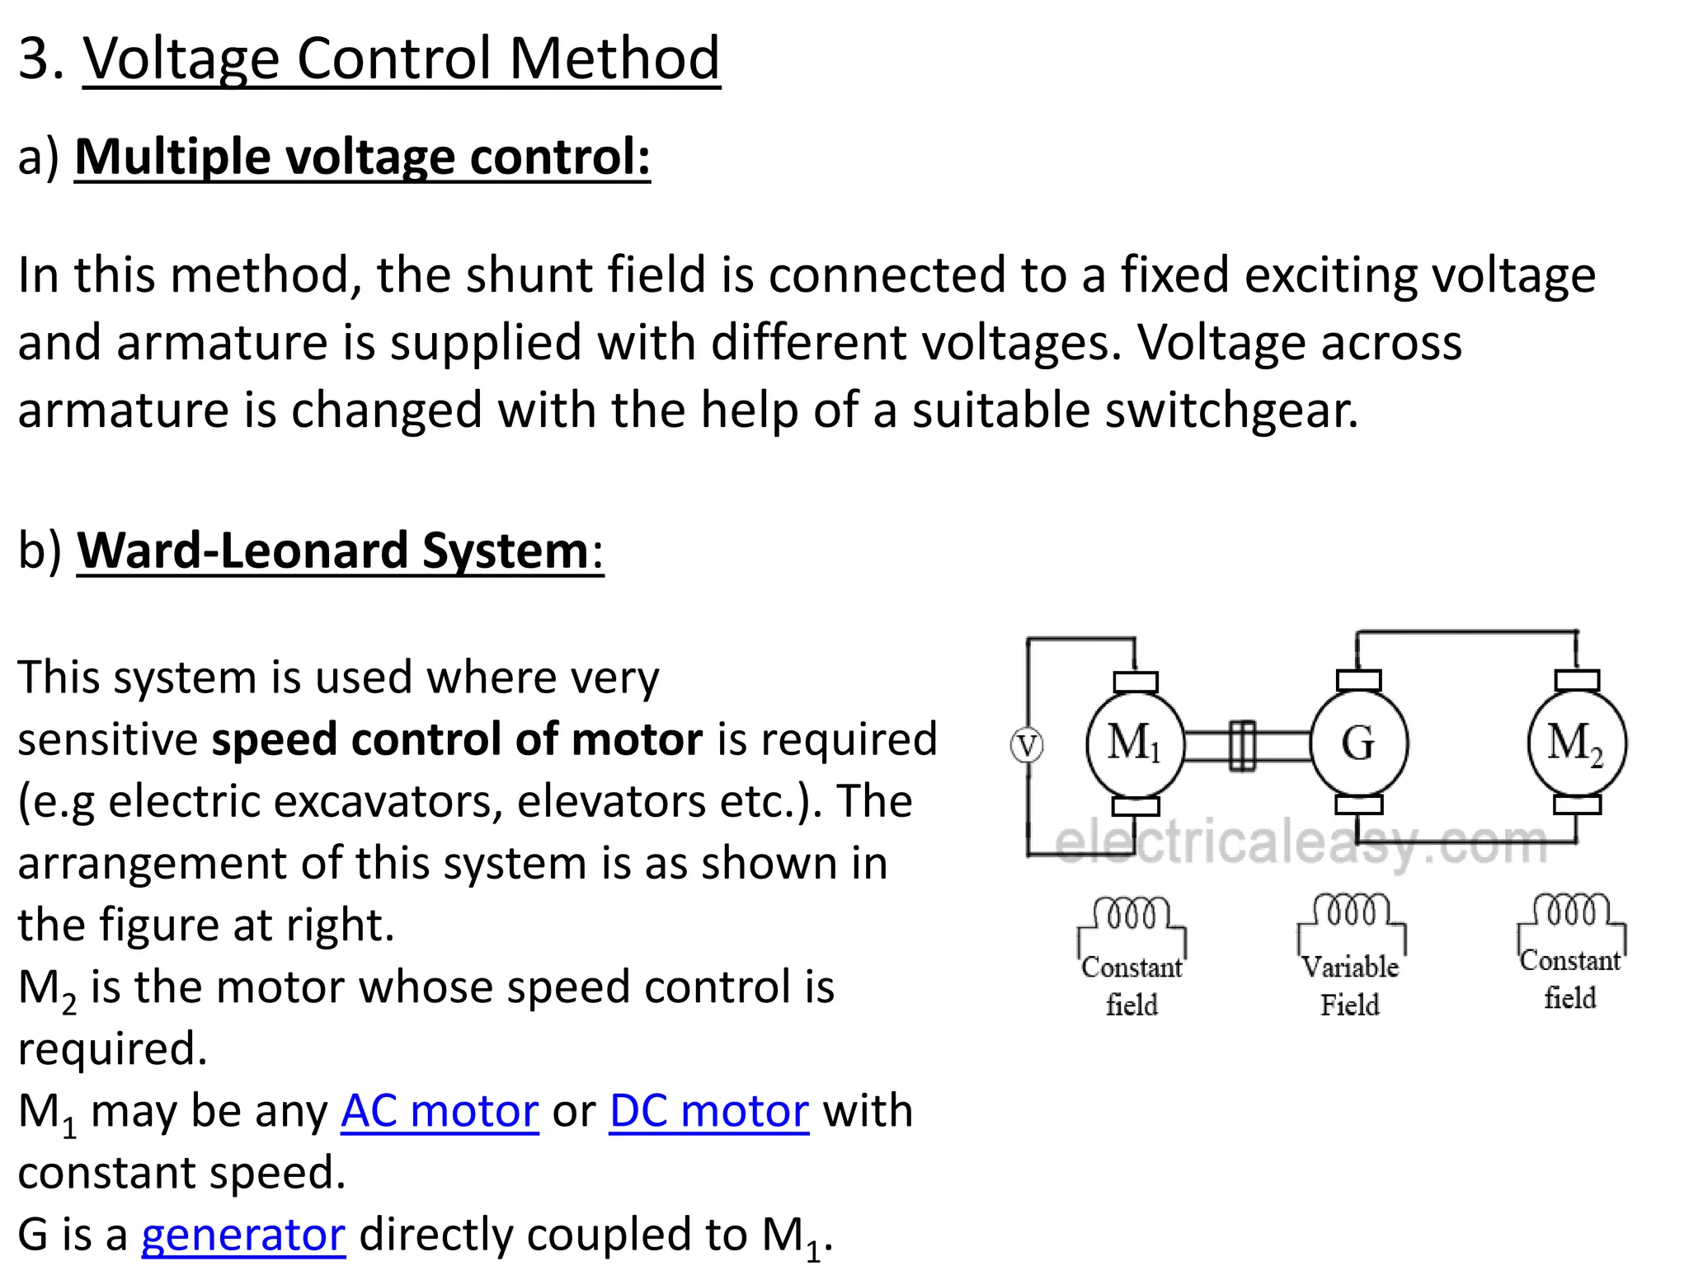

Slide 21
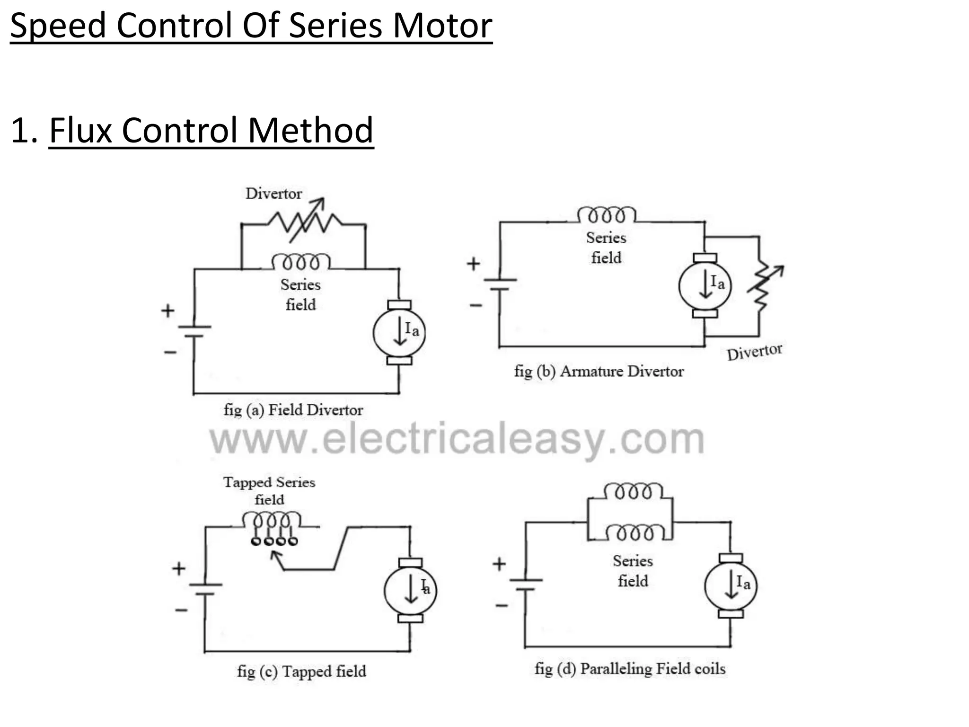

Slide 22
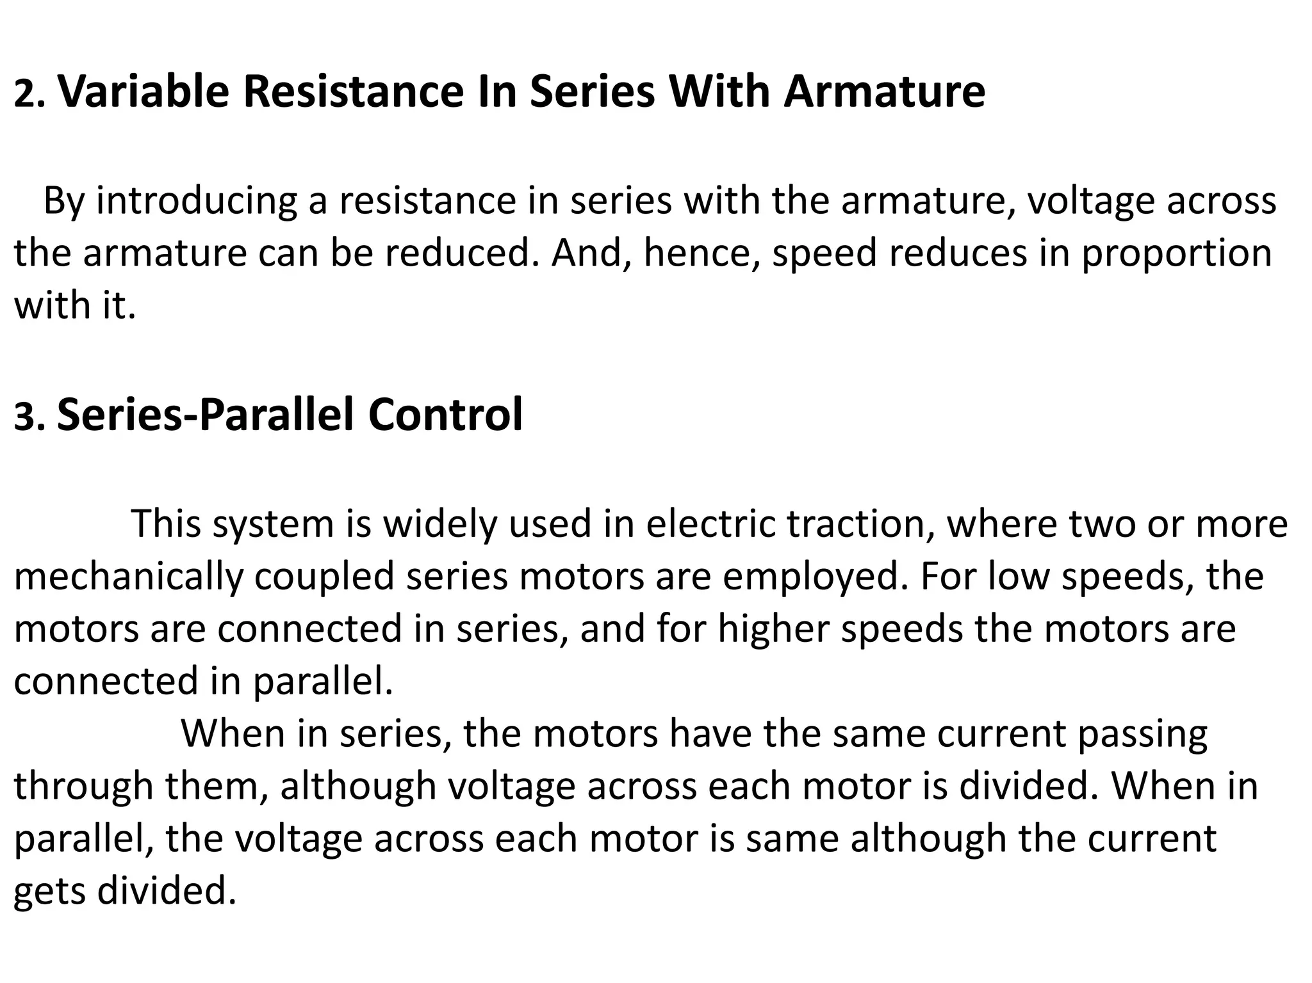

Slide 24
Losses in a DC Motor
In DC machines (generator or motor), the losses may be classified into three categories namely,
Copper losses
Iron or core losses
Mechanical losses
All these losses appear as heat and hence raise the temperature of the machine.
They also reduce the efficiency of the machine.

Slide 25
Losses in a DC Motor
Constant and Variable Losses
In DC machines, we may group the above discussed losses in the following two categories
Variable Losses
Constant Losses

Slide 26
Losses in a DC Motor
Those losses in a DC machine that remain constant at all loads are called constant losses.
These losses include −
iron losses: eddy current and hysteresis loss
Shunt field copper loss, and
mechanical losses.
Mechanical losses: friction and windage losses

Slide 27
Iron Losses
The iron losses occur in core of the armature of a DC machine due to rotation of the armature in the magnetic field.
Because these losses occur in core of the armature, these are also called core losses.
There are two types iron or core losses namely hysteresis loss and eddy current loss.

Slide 28
Hysteresis Loss
The core loss that occurs in core of the armature of a dc machine due to magnetic field reversal in the armature core when it passes under the successive magnetic poles of different polarity is called hysteresis loss. The hysteresis loss is given by the following empirical formula,
Hysteresisloss, Ph=khB1.6maxfV
Where, kh is the Steinmetz’s hysteresis coefficient,
Bmax the maximum flux density, f is the frequency of magnetic reversal, and V is the volume of armature core.
The hysteresis loss in dc machines can be reduced by making the armature core of such materials that have a low value of Steinmetz’s hysteresis coefficient like silicon steel.

Slide 29
Eddy Current Loss
When the armature of a DC machine rotates in the magnetic field of the poles, an EMF is induced in core of the armature which circulates eddy currents in it. The power loss due to these eddy currents is known as eddy current loss. The eddy current loss is given by,
Eddy current loss, Pe = ke B2 max f2 t2 V
Where, Ke is a constant of proportionality, and t is the thickness of lamination.
From the expression for eddy current loss it is clear that the eddy current loss depends upon the square of thickness of lamination.
Therefore, to reduce this loss, the armature core is built up of thin laminations that are insulated from each other by a thin layer of varnish.

Slide 30
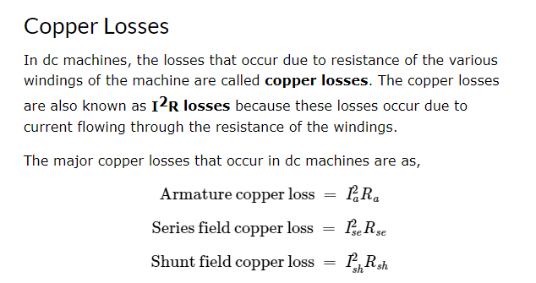

Slide 31
Mechanical Losses
The power losses due to friction and windage in a dc machine are known as mechanical losses.
In a dc machine, the friction loss occurs in form of bearing friction, brush friction, etc.
while the windage loss occurs due to air friction of rotating armature.
The mechanical losses depend upon the speed of the machine.
But these losses are practically constant for a given speed.

Slide 32
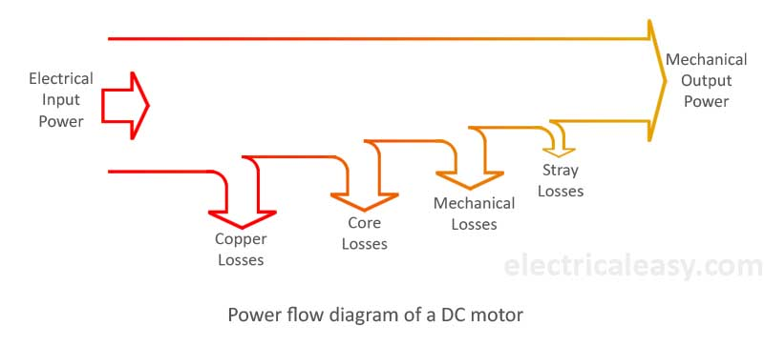
Power flow diagram in a DC Motor

Slide 33
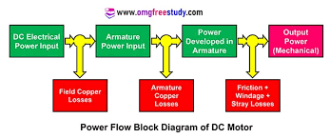

Slide 34
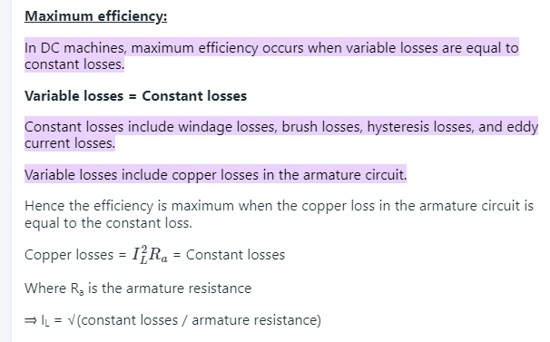

Slide 35
Testing on DC Motors
Direct & indirect methods of testing of DC motors
Swinburne’s test.
Field’s test.
Merits and Demerits of tests.
Numerical as applicable

Slide 36
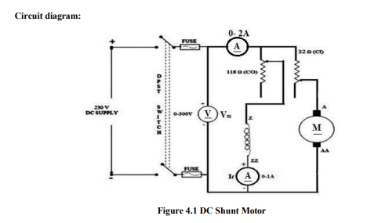
Swinburne’s test.

Slide 37
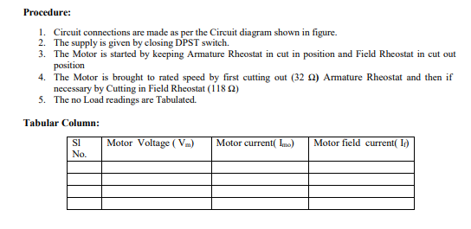

Slide 38
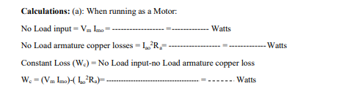

Slide 39
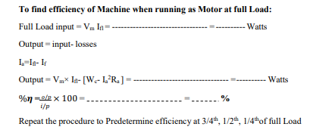

Slide 40
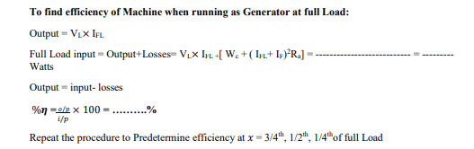

Slide 41
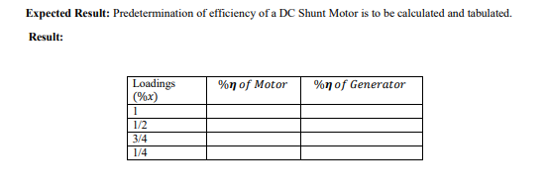

Slide 42
Advantages of Swinburne's Test:
The power required for the testing of large machines is very small, therefore it is an economical and convenient method of testing DC machines.
As the constant losses are known, thus the efficiency can be pre-determined at any load.

Slide 43
Disadvantages of Swinburne's Test:
The change in iron losses is not considered from no-load to full load.
Since Swinburne's test is performed on no-load, thus it does not indicate whether the commutation on full load is satisfactory and whether the temperature rise would be within specified limits.

Slide 44
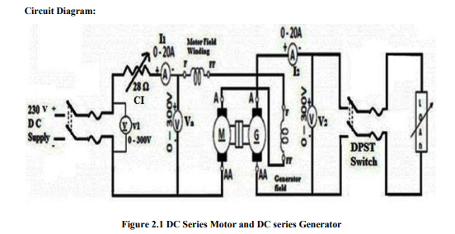

Slide 45
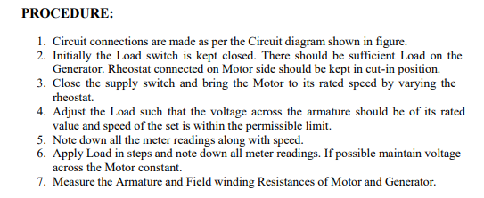

Slide 46
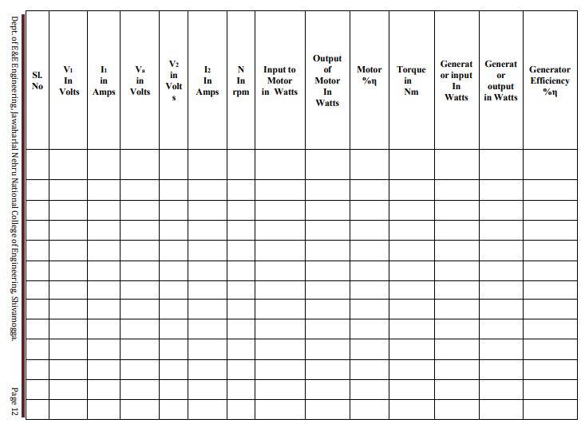

Slide 47
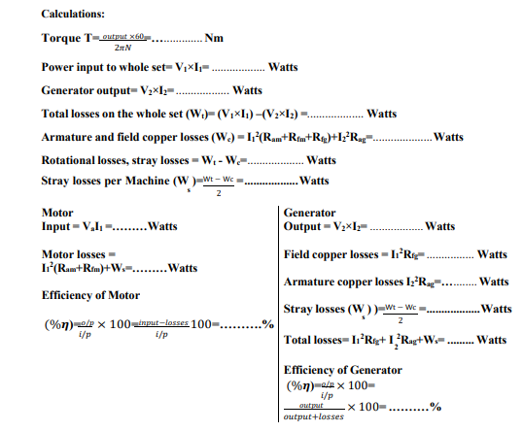

Slide 48
Advantages:
This is the most commonly used test of flexibility, so there is lots of data for comparison. Also, it is a cheap, easy and quick test to perform.
Disadvantages:
Field testing can be time-consuming because it requires a large resource allocation:
dedicated QA teams taking devices out into real-world scenarios.
Purchasing a wide range of devices (with different models or versions) for adequate field testing will cost thousands of dollars annually.

Slide 49


